Slide 1

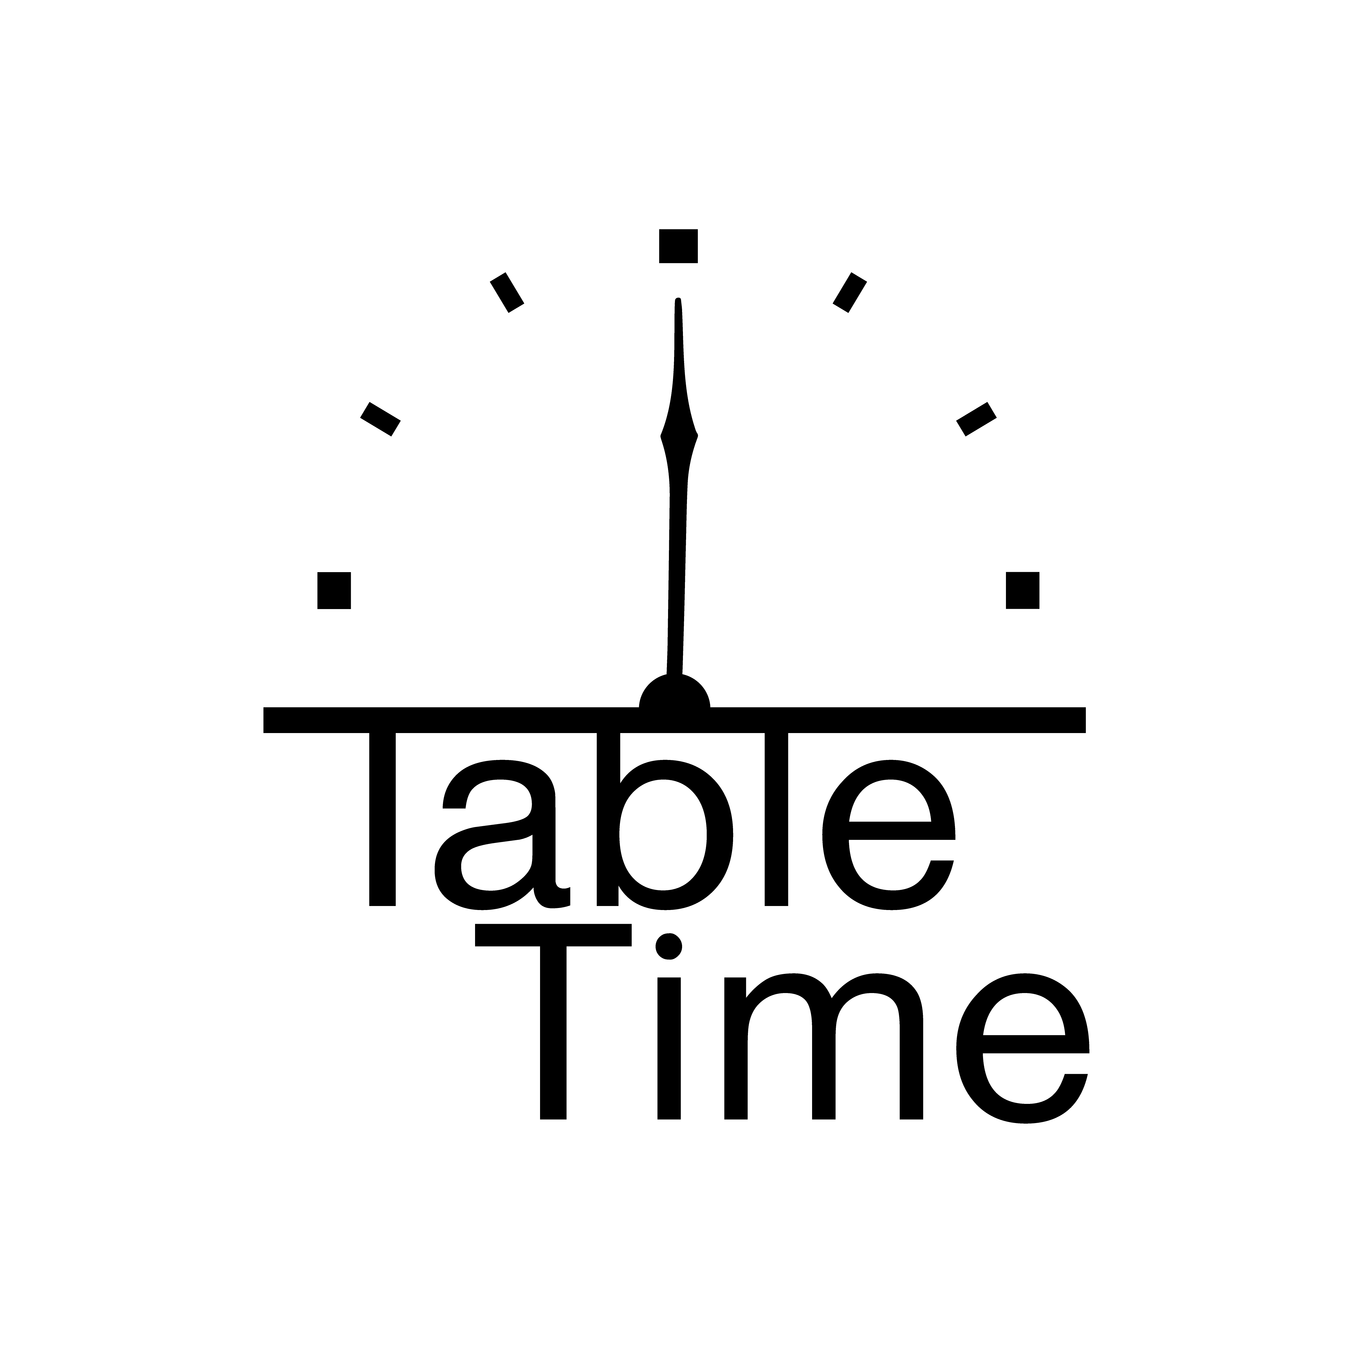
Senior Project
Students:
Turki Abdu Hmq 1845928
Salman Said Alshehri 1937400
Supervisor:
Dr. Ayman Yafoz

Slide 2
TABLE OF CONTENTS
Page 2
Page 4
Page 10
Page 16
Problem Statement And Stakeholders
System Structure & Implementation
Introduction
System Testing
Page 19
Page 21
Page 25
System Demo
Conclusion
Limitation & Future Work
1

Slide 3
1. Introduction
Why Table Time?
2

Slide 4
1.1 Introduction
Waiting time at restaurants impacts customer satisfaction, and traditional reservations are no longer ideal. Table Time application presents a new way to make reservations using NFC technology, which is a form of IoT.
3

Slide 5
2. Problem Statement And Stakeholders
What is the average yearly waiting time in the United States?
4

Slide 6
2.1 Problem Statement
In the United States, consumers spend over 37 billion hours per year waiting in restaurants [1]. This affects consumer satisfaction as well as restaurant’s income growth. Reservation applications solve this, although they have limitations, such as the inability to pick table spot.
5

Slide 7



2.2 Stakeholders
The customers
The employees
The owners
The key focus of our application.
Restaurant employees who use our application to serve customers.
Restaurant owners utilize our application to register and manage their restaurants.
6

Slide 8
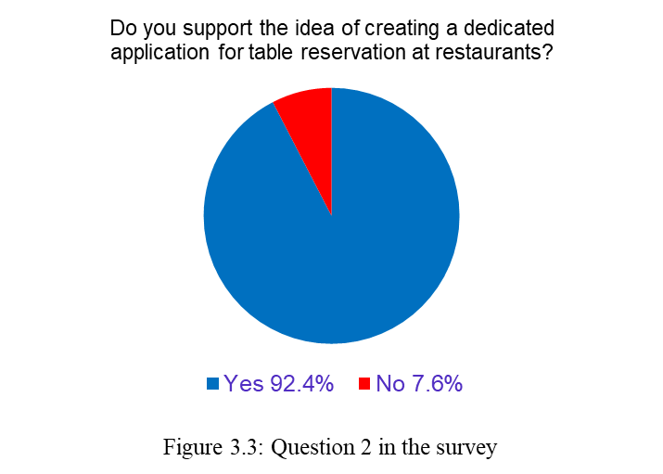
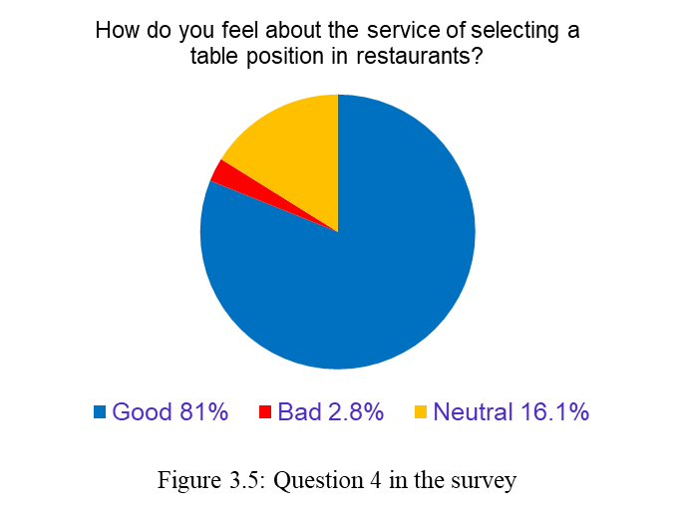
2.3 Customer Survey Results
7

Slide 9
2.4 Owner Survey Results
6. Do you like our application’s design?
One restaurant owner liked the application’s design, while the other had mixed opinions.
7. Are you interested in adopting our application in your restaurant?
One restaurant owner is interested in using our application in his restaurant, but the other is not.
8

Slide 10
2.5 Survey Analysis
According to the study’s findings, there is a strong demand for reservation applications, they like the idea about choosing their table position. Meanwhile, restaurant owners are open to incorporating Table Time into their reservation system, as long as their concerns are addressed.
9

Slide 11
3. System Structure and Implementation
What are the tools used to make Table Time?
10

Slide 12
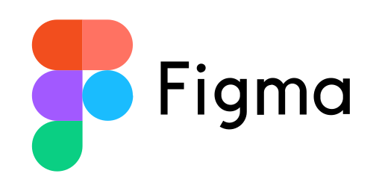

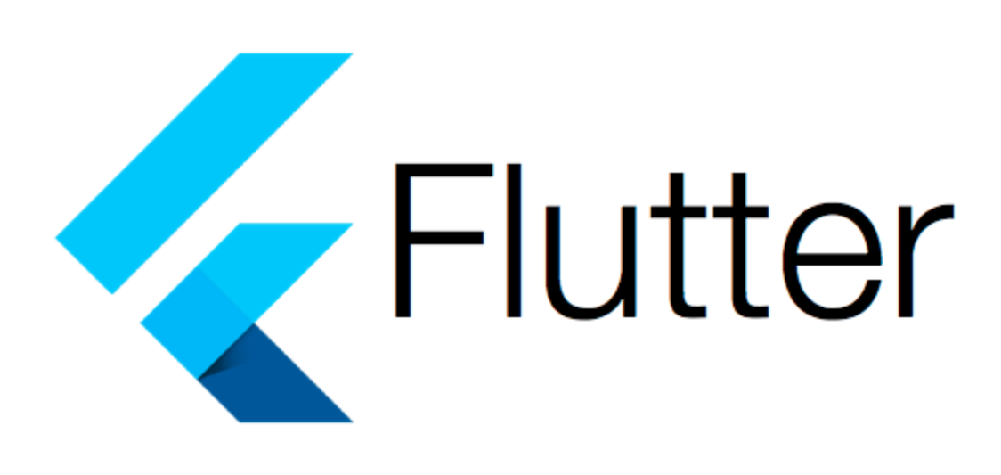


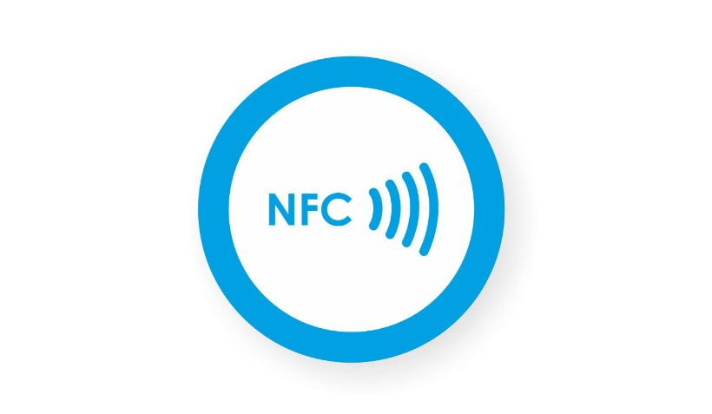

3.1 Overview of implementation Tools
11

Slide 13
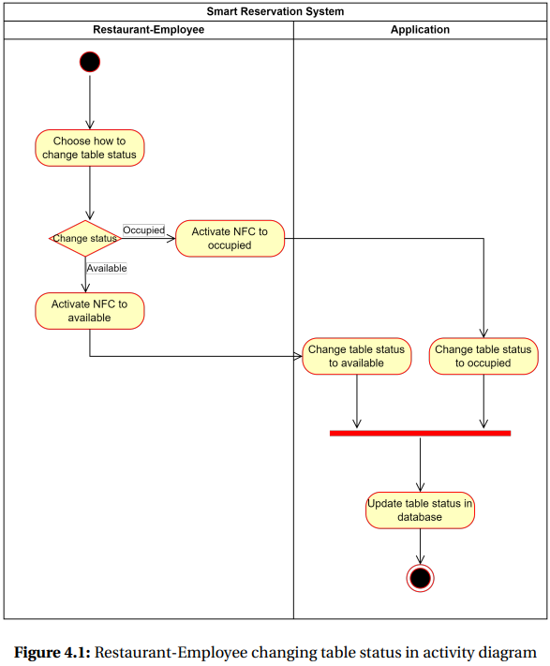
3.2.1 System Structure
12

Slide 14
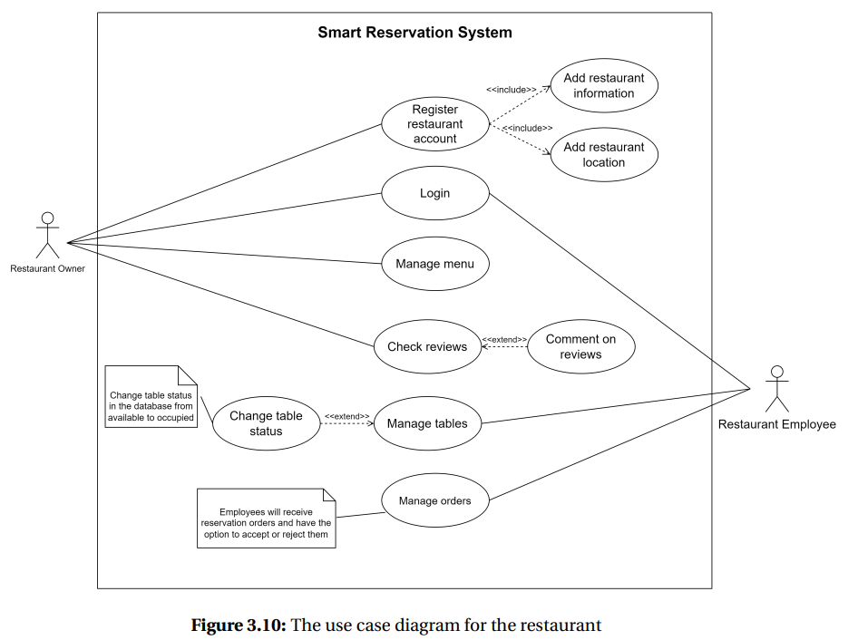
3.2.2 System Structure
13

Slide 15
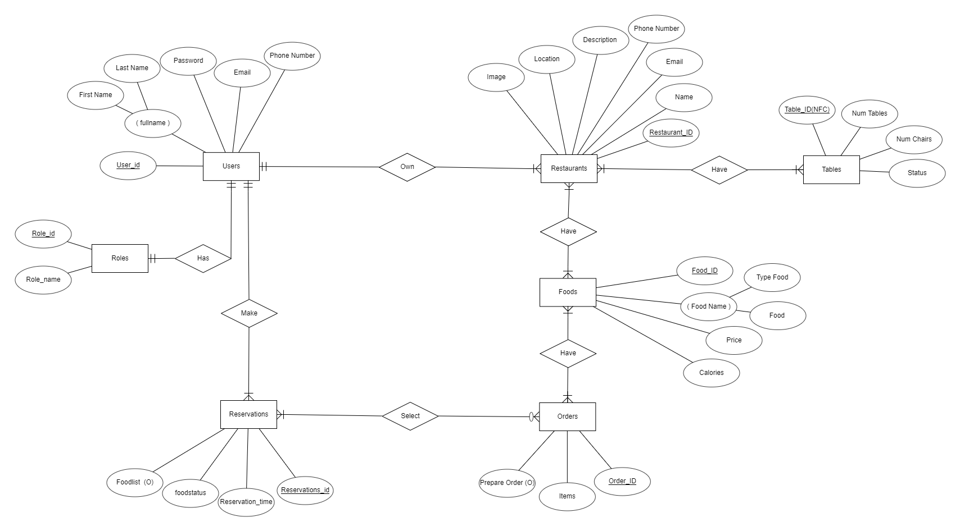
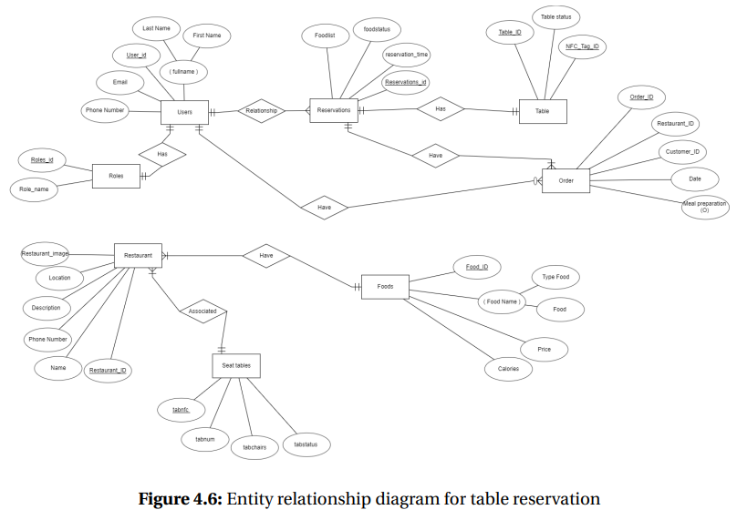
3.2.3 System Structure
14

Slide 16
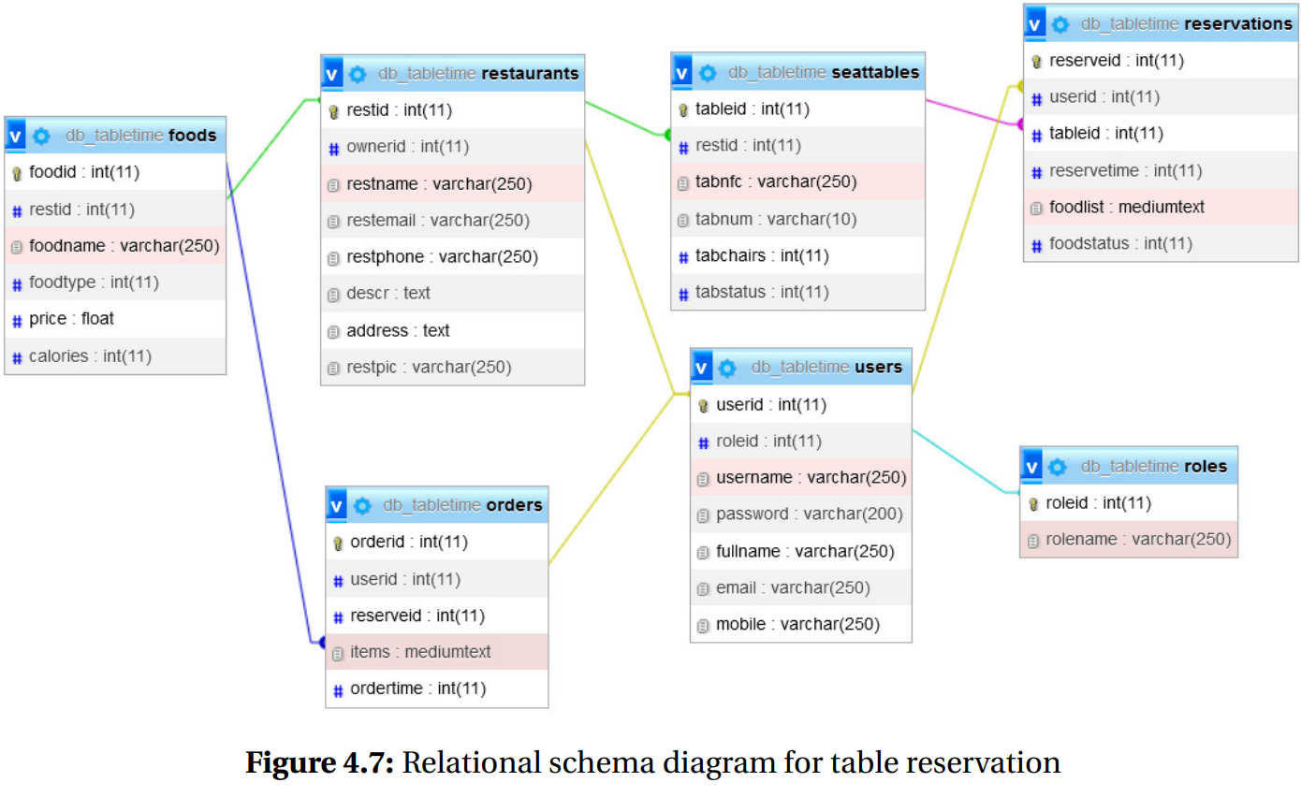
3.2.4 System Structure
15

Slide 17
4. System Testing
What testing techniques have been used?
16

Slide 18
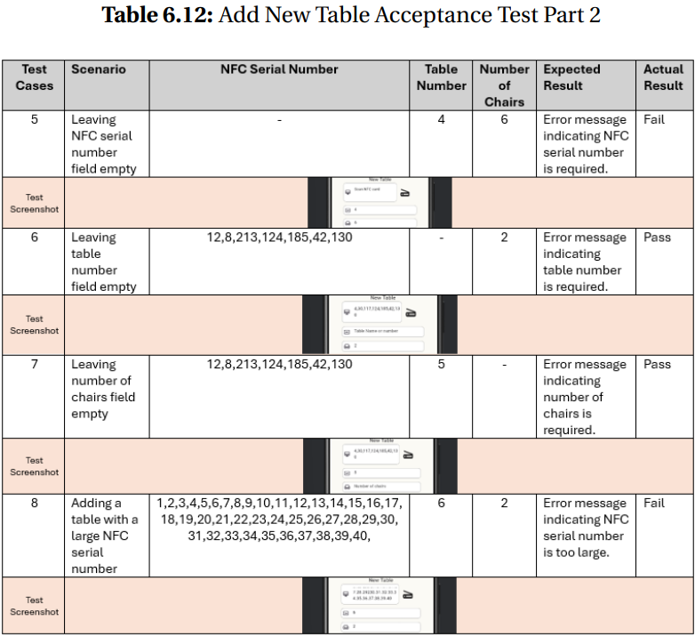
4.1 Black-Box Acceptance Testing
17

Slide 19
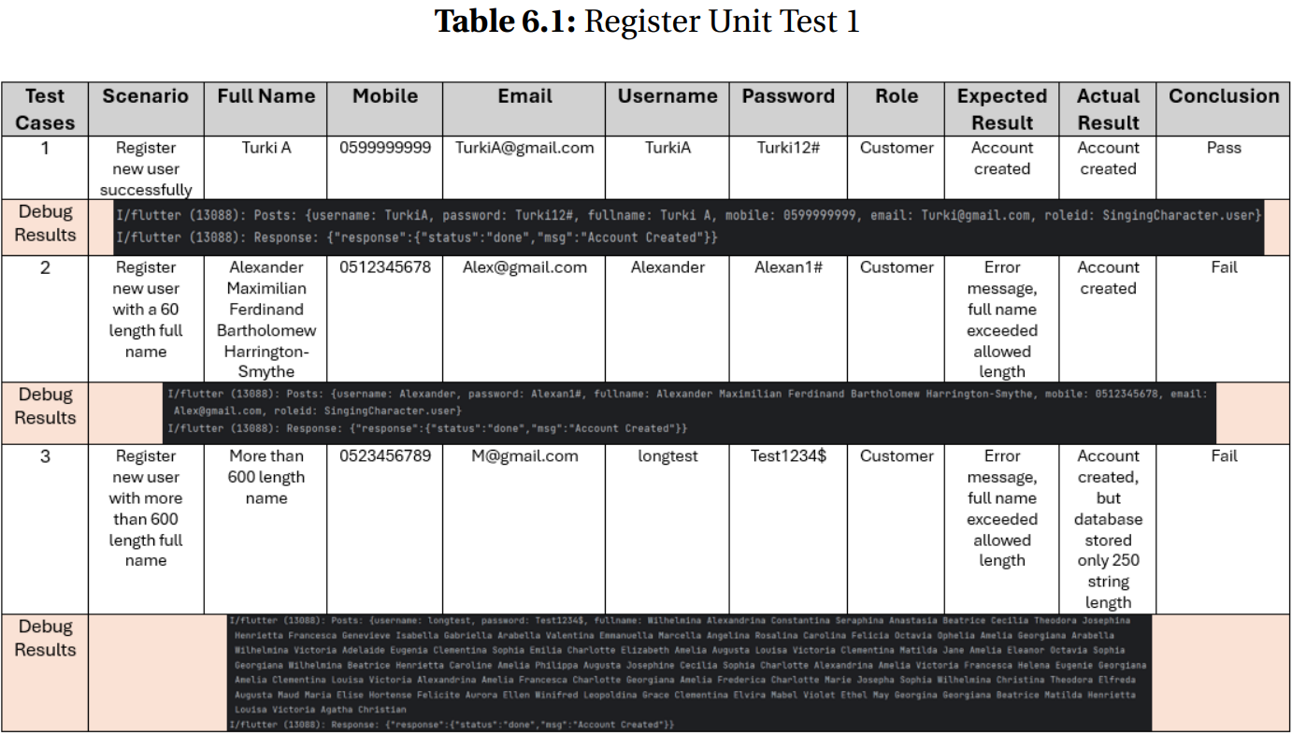
4.2 White-Box Unit Testing
18

Slide 20
5. System Demo
What does Table Time look like?
19

Slide 21
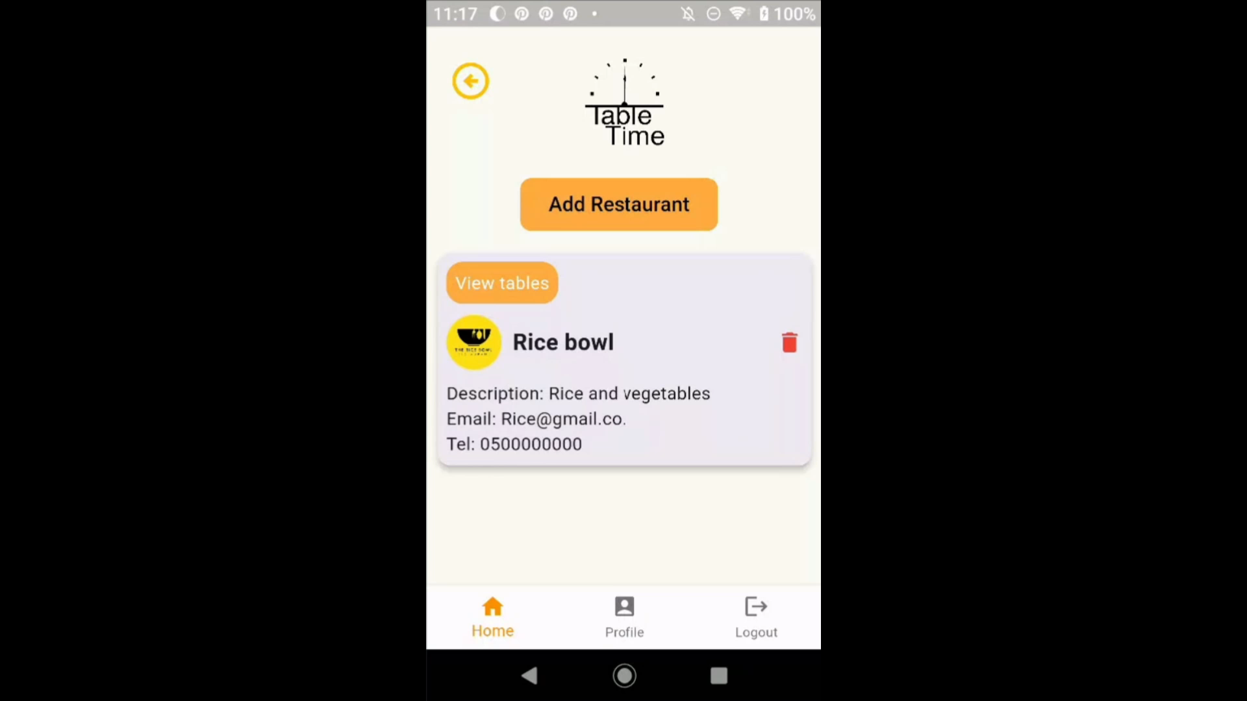
5.1 Video Demo
20

Slide 22
6. Limitation and Future Work
How did the project progress?
21

Slide 23
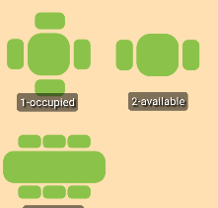
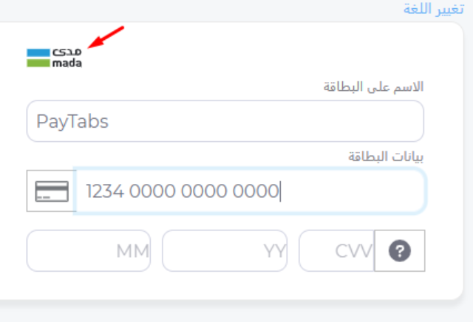
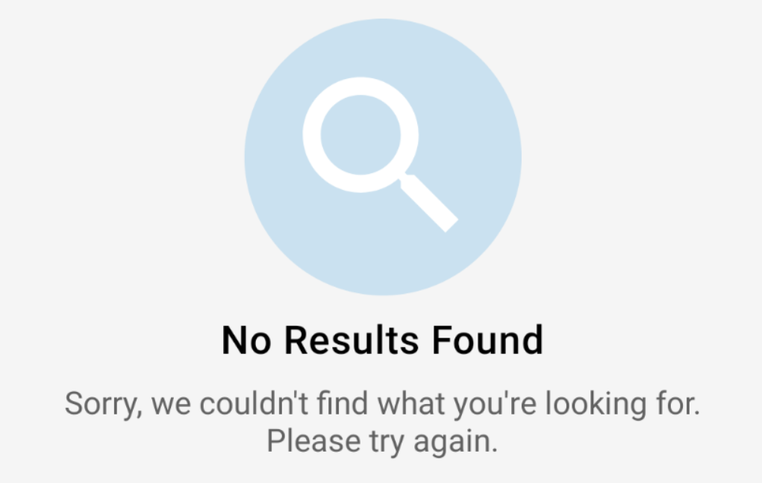
6.1 Challenges
Related Work
Payment System
Graphic Design
Very few restaurant reservation applications made use of NFC technology.
Creating a graphic dynamic restaurant interior map.
Adding a payment system requires End User License Agreement and Privacy Policy.
22

Slide 24
Navigating through a big number of reservation orders on the app may be difficult, but not on the dashboard.
6.2 Limitations
Navigating a large number of tables might be difficult.
Navigating through a big number of reservation orders on the app may be difficult, but not on the dashboard.
23

Slide 25
Adding an expert-written End User License Agreement and Privacy Policy.
6.3 Future Work
Adding a graphical design for tables.
Adding an expert-written End User License Agreement and Privacy Policy.
Polishing and publishing TableTime.
Integrate Table Time into Foodics.
24

Slide 26
7. Conclusion
What are our thoughts on the project?
25

Slide 27
7.1 Conclusion
The Table Time application makes restaurant reservations easier by utilizing NFC technology.
Positive survey results indicate high consumer support.
Table Time will go through further development before being released on Google Play and the App Store.
26

Slide 28
Reference
[1] J. De Vries, D. Roy, and R. De Koster, “Worth the wait? How restaurant waiting time influences customer behavior and revenue,” Journal of Operations Management, vol. 63, no. 1, pp. 59–78, May 2018, doi: 10.1016/j.jom.2018.05.001.
27

Slide 29
Any question?

